Slide 1
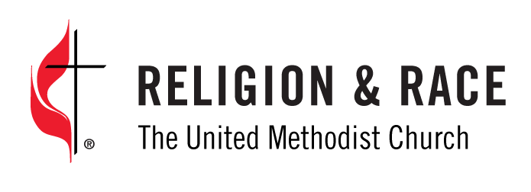
People of color in the decision-making processes of The United Methodist Church
An abbreviated retrospective

Slide 2
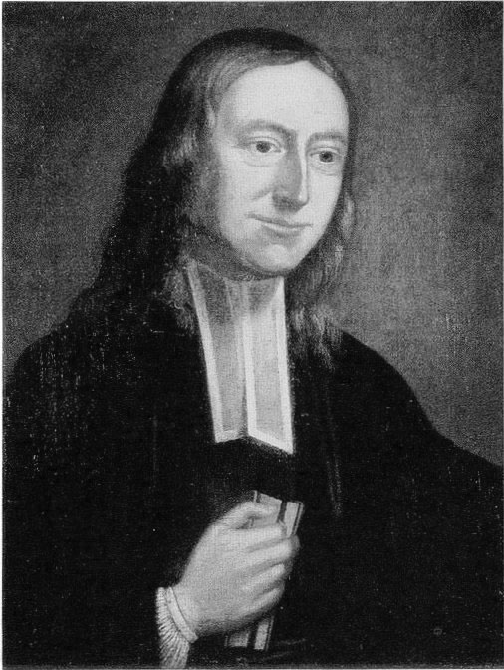
A brief timeline
1784 The organizing “Christmas Conference” is held in Baltimore, the first General Conference for the
new Methodist Episcopal Church.
1790 Methodism’s founder, John Wesley, dies. In his last letter to a friend, Wesley decries the institution of slavery as “the vilest that ever saw the sun.” Because of the antislavery message of our new church,
membership grows to 57,000 people in 40 years, with 20% of those being people of color.
1844-5 U.S. Methodists split over the issue of owning black people as slaves, and the
Methodist Episcopal South breaks away to create its own denomination.
1864 Led by a Methodist pastor and military officer, the U.S. Calvary slaughters 160 women, children
and elderly men from the Arapaho and Cheyenne nations on their own land in Colorado.
After this Sand Creek Massacre, Native American and Latina/Latino children are routinely
stolen from their families and taken to Methodist mission schools, where their heritage and customs
are obliterated.

Slide 3
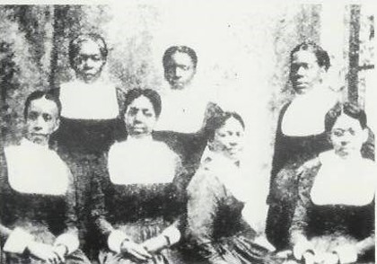
We’ve always been here, but equity and inclusion for people of color is relatively recent
The UMC has only been legally desegregated by race since 1968.
In 1972, less than 13% of women were General Conference delegates.
It wasn’t until 1976 that the first women of color was elected national president of United Methodist Women. Before that, most mission societies were racially separate as to leadership.
The first women of color district superintendents were not appointed until the 1980s.
Black deaconesses, circa. 1900.

Slide 4
2019 U.S. population and United Methodist membership
U.S. population is 40% people of color
U.S. UMC membership is 92% white
Latino/Hispanics —18.3%
Blacks/African/Caribbean — 13.4% (non-Hispanic)
Asian — 5.9%
Native American/Indigenous —1.3%
Pacific Island/Native Hawaiian — .2%
Biracial/Multiracial —2.7%
Across the globe, the fastest-growing segments of The United Methodist Church are on the continent of Africa.
The missional priorities, decisions about church growth and development of resources are largely focused on white, U.S. mid- to large-sized, English-speaking congregations (200 or more in worship) with paid education and music staff.
There are no comprehensive church-growth and evangelism plans for communities among people of color or people who are working class or poor.

Slide 5
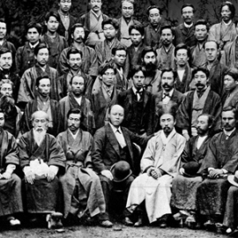
1903 First Korean immigrants to U.S. begin Methodist faith communities in Hawaii. 1939 Northern and Southern U.S. branches reunify, segregating black United Methodists into their own judicatory, the Central Jurisdiction, with its own parallel conference structures and bishops. 1944 The Indian Mission (now the Oklahoma Indian Missionary Conference) is formed, comprising 40 tribal groups displaced by the U.S. government to lands in the middle and southwest. 1968 The United Methodist Church is created from union of former Methodist and Evangelical United Brethren churches. Due to pressure from the Evangelical United Brethren and people of color, the racially segregated Central Jurisdiction is abolished. —Black Methodists for Church Renewal —the first of five U.S. caucuses to advocate for people of color in the UMC is created. —United Methodists in five African nations unite into one Central Conference, and the late Abel T. Muzorewa is elected as the first native African bishop, assigned to his native Zimbabwe.
As people of color find their voices, they cry out for Christian justice

Slide 6
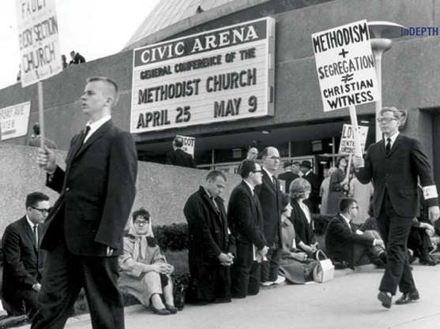
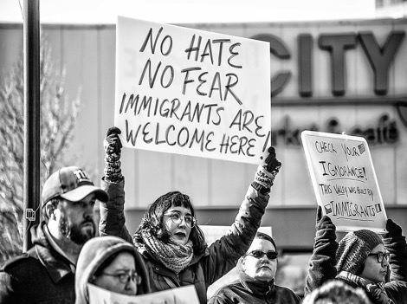
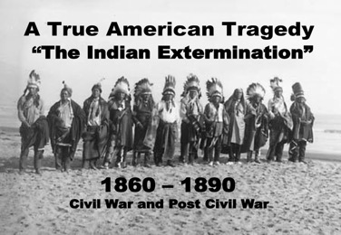
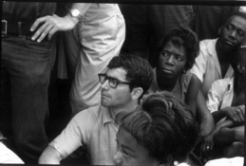
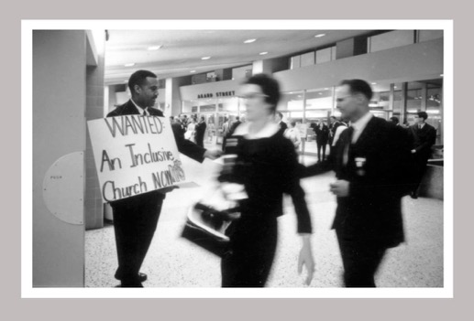
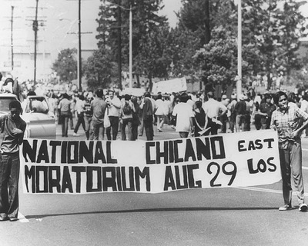
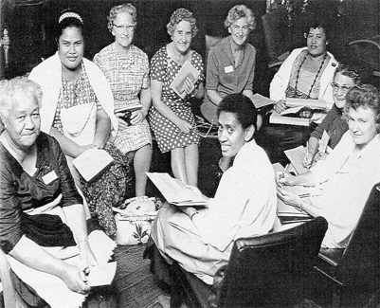
The struggle for racial equity continues…

Slide 7
1968 Bishop Roy Nichols is the first African-American elected to the episcopacy in the newly desegregated United Methodist Church. Before this, black bishops were only elected by and appointed to the Central Jurisdiction. 1970 A specially called General Conference finishes the legal work of union between the Methodist and EUB churches and of dismantling formerly racially segregated structures. Some annual conferences in the U.S. South resisted desegregation until as late as 1974. 1971 The second racial justice caucus, MARCHA, serving the cause of Latino/Latina United Methodist, is created. The Federation of Asian-American United Methodists and the Native American International Caucus follow. Later, Pacific Islander United Methodist Caucus forms. The five (5) ethnic caucuses are “official” entities and the only caucuses named in The Book of Discipline. 1972 The Rev. Wilbur Choy, a Chinese-American clergyman, is elected the first Asian-American United Methodist bishop by the Western Jurisdiction. 1972-6 The Black College Fund and the HANA scholarships are created to support black, Hispanic, Asian- Pacific Island and Native American pursuing college degrees.

Slide 8
1976 General Conference names “Strengthening the Ethnic Local Church” as a the denomination’s missional priority for the next 12 years. 1980-4 A white U.S. United Methodist clergywoman, the late Marjorie Matthews, becomes the first women in mainline U.S Christianity to be named a bishop. Four years later, clergywoman Leontine T.C. Kelly is elected the first black woman bishop in the United Methodist Church and in mainline Christianity, and our own Elias Galvan of Mexico, is elected the first Latino bishop in United Methodist history. 1988 General Conference approves creation of UMC-related Africa University in Zimbabwe. Four years later, the university opened with 40 students from six African nations. 2000 The Puerto Rico Annual Conference (formerly a part of the Northeastern Jurisdiction because of the institutional racism still inherent in the U.S. South) become an autonomous, affiliated church. 2004 Minerva Carcaño is elected the first Latina bishop of the United Methodist Church. 2008 The Revs. Rosemarie Wenner of Germany and Joaquina Nhanala of Mozambique, are elected the first United Methodist women bishops beyond the United States.

Slide 9
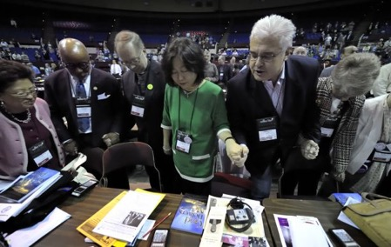
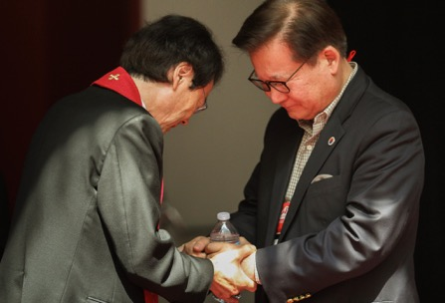
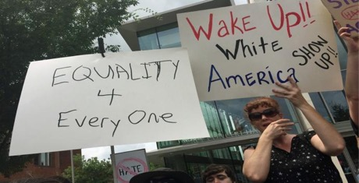
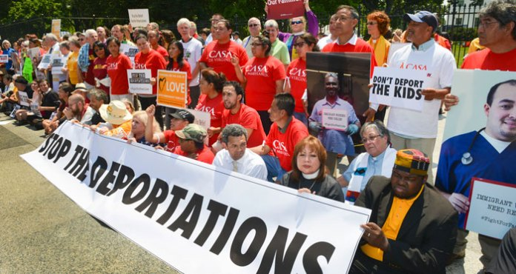
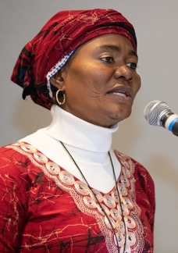
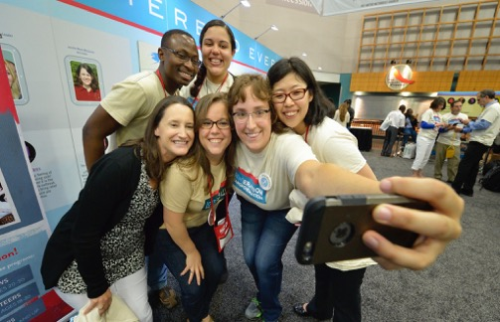
How does a fully inclusive Christian church bear witness and fully live out the Gospel of Jesus Christ??

Slide 10
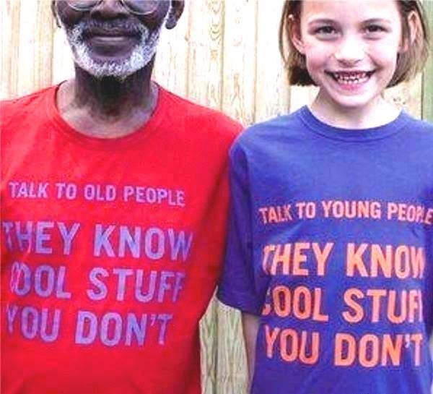
` Conference By the numbers
Within the first 40 years of American Methodism, membership was more than 20% people of color. Today, it is 8%.
At merger in 1968, our churchwide membership had peaked at more than 12 million members in the United States alone. Today, we have about 11 million worldwide
In 2019, less than 22% of General Conference delegates were U.S. people of color. Number of African delegates rose to more than 30%.
The majority of General Conference delegates are over 55 years old, and the largest number of U.S. lay delegates are retired.
.

Slide 11
What our history has taught us…
People of color have always been a part of the United Methodist Church.
The struggle for equity and justice is real and continuing in the United Methodist Church.
Since 1968, our denomination in the U.S. has lost membership and vitality among all racial groups. And we are being called by God to repentance and renewal.
God still has work for us to do. God still has souls to claim and a world to transform.
We stand on the shoulders of Christians who sacrificed for our place at the table.

Slide 12
For more information follow us at http://gcorr.org
Thank you!

